Slide 1
How we approach product development at Nebraska Global
Doug Durham
Chad Michel

Slide 2



Slide 3
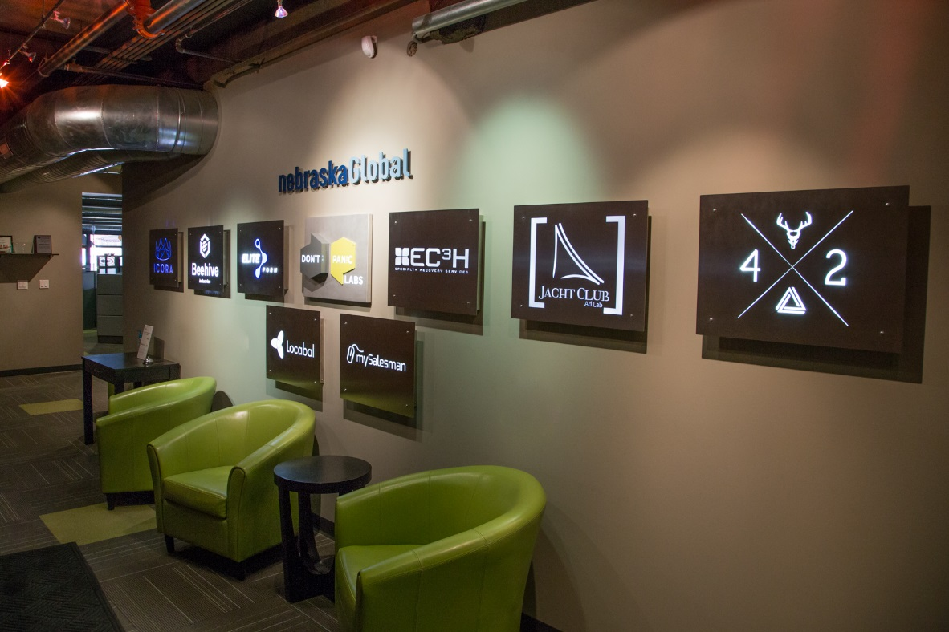
About Nebraska Global
Formed in April, 2010
Located in Lincoln, NE
Founded by people with decades of experience in commercial software product development
Unique model…
Establish an investment fund and combine these dollars with a product development team to build software products and companies
Develop young software engineers / entrepreneurs
Core development team has been together since early 2000’s
Notes:
Soft goals of NG:
Building an ecosystem of software tech companies in Lincoln and Nebraska
Being a model and promote sound software development patterns and practices
Focus on business models and fundamentals that are more traditional (as opposed to Silicon Valley startups)

Slide 4
Other challenges unique to NG
We are building startups
Radically different problem domains
Product development team is an “elastic resource”
Move folks around
Integration of new and inexperienced team members
Development of software designers/architects
Development of young engineers

Slide 5
Lessons we had learned from our previous experience
Big jump from requirements to code
No software architecture / design
Resulting code tends to be…
Inconsistent/incoherent
Overly complex and “clever” code
Difficult to maintain
Poorly documented/commented
Lack of ongoing integration means end of release cycles require lengthy “stabilization” phases
Releases are quickly followed by a string of hot fixes
Painful “first birth”
Notes:
Big jump from requirements to code
Where is the design process and discipline in this approach?
Development teams begin implementing features following something that resembles object-oriented design
Each new component of the application introduces a new “pattern”

Slide 6
Lessons we had learned from our previous experience
Within a few years you start to hear and see things like…
“Jeff is the one who designed that system and only he really knows how it works”
“If we are going to change this much we should just start over and re-write the system but do it right this time”
Every new feature requires an individual spend more and more time trying to understand the broad system to determine potential for unintended behavior
More and more time (and anxiety) associated with each release
Notes:
Big jump from requirements to code
Where is the design process and discipline in this approach?
Development teams begin implementing features following something that resembles object-oriented design
Each new component of the application introduces a new “pattern”

Slide 7






Core Values
Proven Patterns
and Designs
Layered Approach
to Quality
Always Have
a Plan
Adaptive
Processes
Individual
Accountability
Expect Change
“Make everything as simple as possible, but not simpler.” -- Albert Einstein
Notes:
Always Have a Plan - You would never build something as complex as a house without a set of plans to guide the construction. We believe the same is true for building software that is developed and maintained by teams.
Proven Patterns and Designs - We understand that few problems are unique and require novel solutions. We strive to adopt proven patterns and designs whenever possible, and only develop from first principles when absolutely necessary.
Critical: Design for Testability
Adaptive Processes - No two projects are identical, so no single approach to design and project management is ever appropriate. That is why we adapt our processes and practices to each new project. We ensure we are adding value by everything we do.
Expect Change - The only thing that is consistent about requirements is that they will change in form and in priority, so we use iterative/Agile approaches for development and releases. It is also why we design our systems to allow for change to occur in a managed and localized way.
Layered Approach to Quality - There is no one software practice that will find every bug. That is why we employ a layered approach to quality that includes automated unit/integration testing, code reviews, pair programming, etc.
Individual Accountability - Hierarchy and bureaucracy are rarely beneficial in creative endeavors, which is why we promote accountability and decision-making at both the individual and team levels.

Slide 8
How we approach product development
We wanted a “disruptive” vs “evolutionary” change
How we are organized
How we plan
How we design software
How we take a layered approach to quality
Additional factors improving developer productivity

Slide 9
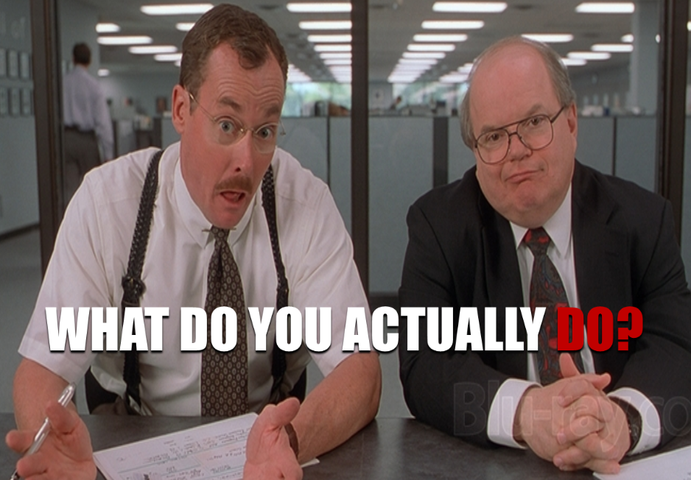
Our roles
Project Managers
aka Scrum Master
Process managers
Our “force multiplier” – make the development process far more efficient
Lead Engineers
Responsible for ensuring the integrity of the design
Have the “big picture” in their head
Architects
Work with lead engineers to develop the service architecture of the application
Collaborate across projects and products
Software Engineers
Responsible for the design, build, test and quality of features
UI / UX
Responsible for the analysis, design, and build of user interfaces
Quality Assurance
Focus is more on customer experience and regression testing

Slide 10
Typical team dynamics
Goal:
Optimize developer efficiency
Provide structure and mutual accountability
Enable frictionless collaboration and communication
Eliminate bureaucracy

Slide 11
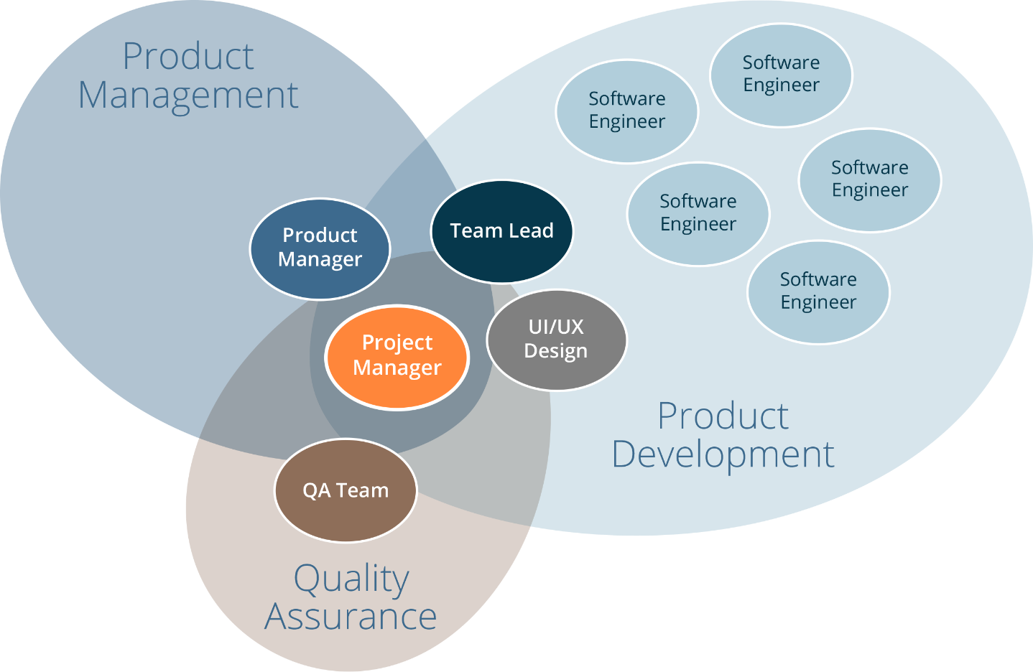
Typical team dynamics
Teams: 4-6 engineers
Project manager is the “hub” for coordination
Team lead / architect works closely with product and project management
Communication flows freely between product management and all team members
QA operates at a product level
NOTE: Very flat org structure. Accountability is to the team vs a manager

Slide 12
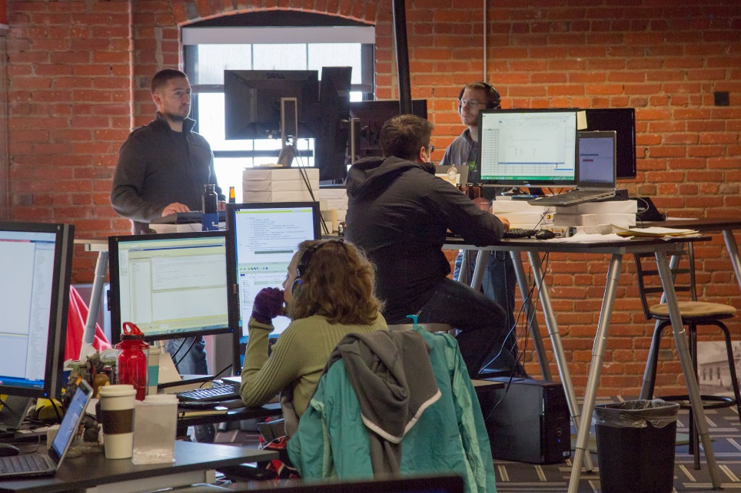
Office layout
Observation: Only a small amount of “friction” is required before impacting collaboration and communication
Our solution…
Open spaces
Adjustable desks
Easy access to breakout rooms
Movement to mobile computing
Headphones ☺
Does have some drawbacks

Slide 13
How we plan
Goals
Create a backlog of stories where each story represents <= 1 week of effort
Create a process that allows for predictable throughput
Treat requirements analysis/story development as a design exercise
Incorporate risk reduction

Slide 14
Story development
Collaboration with product manager/owner to define product/release requirements
Develop UI/UX wireframes as necessary to help with requirement insight and effort estimation
Continue to decompose stories until development team feels effort is <= 1 week
Fixed estimate “buckets”
1 point = 1 week
0.5 = 2.5 days
0.2 = 1 day
0 <= 1 hr

Slide 15
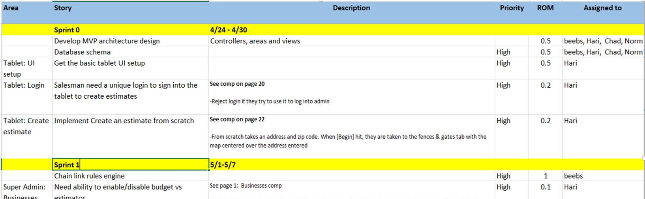
Multi-Sprint Release Planning
Stories are assigned to sprints
Available resources dictate total points available per sprint (i.e. velocity)
Story dependencies, priorities and risks influence where stories appear in the schedule
Resulting sprint plan provides…
Estimate of likely release date (provides visibility to folks outside product development)
Visibility into rationale for sequence and timing
Important: Sprint plan is just a plan, not the law
Every new sprint presents opportunity for adjustment and change in priorities

Slide 16
“Maintenance” development
Move toward a “kanban“ model
Stories are stack ranked and worked in priority order
Releases typically done at end of each sprint
We often ebb and flow back and forth between multi-sprint releases and Kanban releases.
Sometimes at the same time

Slide 17
Sprint planning
IMPORTANT: This is treated as a design process!!!
Stories are broken down into tasks
Tasks are the steps to implement
White papers used for more fluid or complex stories
Observation: Writing things down increases insights into requirements and design
Tasks are estimated
Small (< 4 hrs)
Medium (4-12 hours)
Large (> 12 hrs) (further decomposition?)
Tasks estimates are compared to story estimates
Adjustments made as necessary
Sprints are 1 week (typically)

Slide 18

How we design software
“Always code as if the guy who ends up maintaining your code will be a violent psychopath who knows where you live.”

Slide 19
How we design the software
Software engineering is…
“the multi-person construction of multi-version programs.”-- David Parnas
Consumers use products developed by teams of engineers and these products are continuously changing and evolving
Our solution
Formal software design role/process
Leverage existing design principles
Consistency of design pattern
Consistency of design conventions
“Global” design criteria

Slide 20
Leveraging existing principles
Information hiding
Designing for change
Separation of concerns
Maximize functional cohesiveness
Minimize coupling
Favor closed vs open architecture

Slide 21
Consistent software design process
IDesign “Method”
http://www.idesign.net
Search “Zen of Architecture”
Encapsulation of volatility / design for change
Information hiding
Every class is a “service”
Service orientation vs object-orientation
Multiple views of the design
Simplified conventions and rules

Slide 22
Consistent design conventions
Basic abstractions
Managers: Manages sequence of actions
Engines: Applies algorithm/business rule
Accessors: Data/resources
Utilities
Client
Layers (typical)
Clients
Business
Resource Access
Resources
Communication rules
Closed architecture
Services can only call down
Utility exception
Not allowed:
Manager -> Manager (sync)
Client -> Engine
Client -> Accessor
Manager / Engine
Accessor
Resource
Utility

Slide 23
Static diagram
Client
Utilities
Admin
Store
Order
Manager
Catalog
Manager
Notification Manager
Fulfillment Manager
Security
Business Logic
Email
Engine
XML Post Engine
Coupon Engine
Pricing
Engine
Logging
Resource Access
Pricing
Accessor
Product
Accessor
Coupon
Accessor
Order Accessor
Credit Card Accessor
Email Accessor
Data
Pricing
Products
Coupons
Orders
Credit Card API
SMTP Service

Slide 24
Characteristics of a Good Design
Minimal complexity
Cleverness == complexity
Minimize your required “field of view”
Ease of maintenance
How easy will it be for any programmer to understand?
Loose coupling
Components with few connections/dependencies on other components
Extensibility
Enhancements to the system do not cause a ripple effect
Encapsulation of volatility (future change)
Inevitable changes are localized
Closed system
Restrictions on inter-component communication
Class/unit level testability
Peace of mind and ability to refactor

Slide 25
Layered approach to quality
Lead engineer with “big picture”
Ensuring design integrity is maintained
Focus on developer accountability for quality
Removal of QA “safety net”
Code + Tests == Feature
No separate “develop tests” tasks

Slide 26
Layered approach to quality
Sprint done
Release done
Coding standards met
User Stories code complete
Unit test developed/passed
Test Clients completed
Priority bugs fixed (blocking bugs)
Priority bugs validated
User Stories documented for QA/documentation
NOTE: These activities fall within the development sprint (i.e. no QA involvement here)
QA Acceptance
Stress testing
Scalability testing
Performance testing
Finalize Customer documentation
Migration checklist
Final QA regression passed
Final Integration test passed
NOTE: these activities fall outside of the development sprints (i.e. QA focus here)

Slide 27
Layered approach to quality
Effectiveness of test processes (“Code Complete”, 2nd Edition)
Regression Test (30%)
Code Reviews (35%)
Integration Test / Design Reviews (40%)
Unit Test (50%)
Desk-Checking (60%)
Layered approach to quality
Pair programmingUnit tests
Code review via GitHub Pull Requests
Regression tests
Integration tests
Automation
Leverage CI tools for build and deployment (even if we are not doing CI)

Slide 28
Additional factors improving developer productivity
Project manager as “force multiplier”…
Primary responsibility: Process facilitator
Ensure steps are followed
Maintain consistency
Keep a productive rhythm
Schedule/facilitate meetings
Keep meetings productive
Ensure proper task prioritization
Central communication for project
Tight coordination with lead engineer, UI/UX, QA and product manager
Decision tracking and documentation
Release plan development
Task/action item tracking
Project status monitoring / reporting
Project health monitoring / reporting
Information/decision coordination
Retrospectives
Management of external communications
Lead daily standups

Slide 29
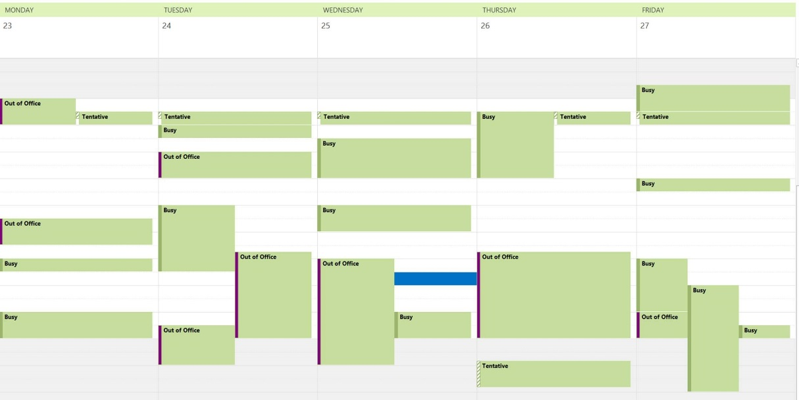
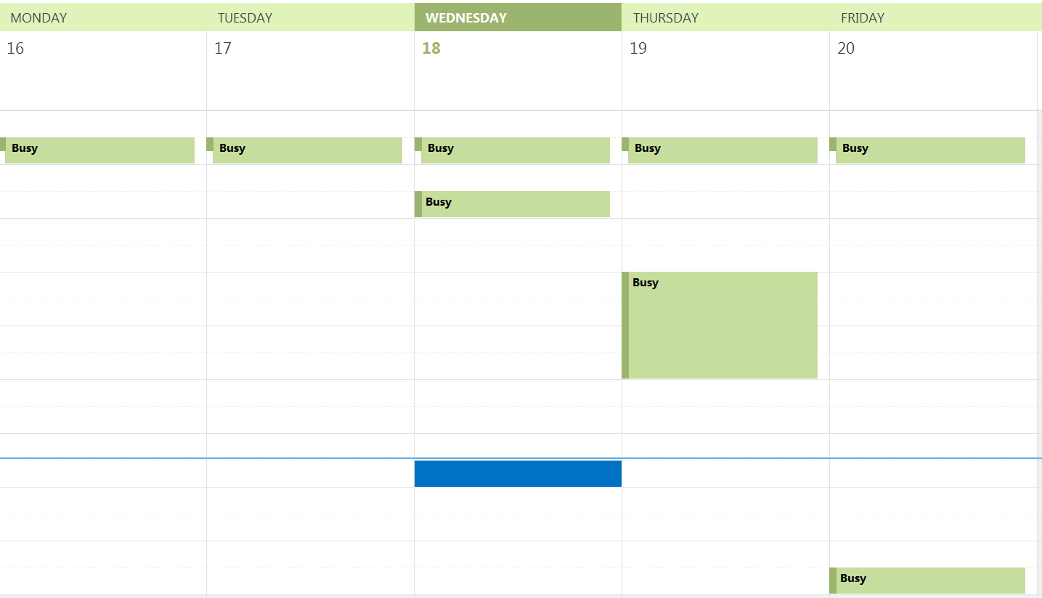
Additional factors improving developer productivity
Maker vs Manager Schedule
Paul Graham (Y Combinator): http://www.paulgraham.com/makersschedule.html

Slide 30
Case Studies
EliteForm
Beehive

Slide 31
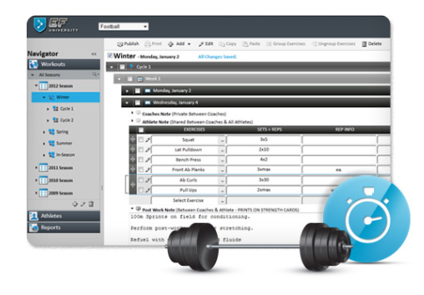
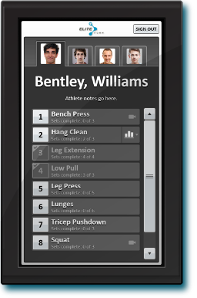
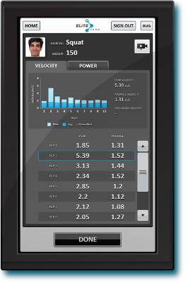
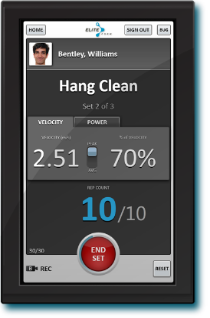
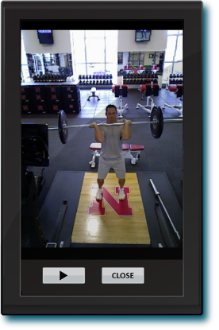
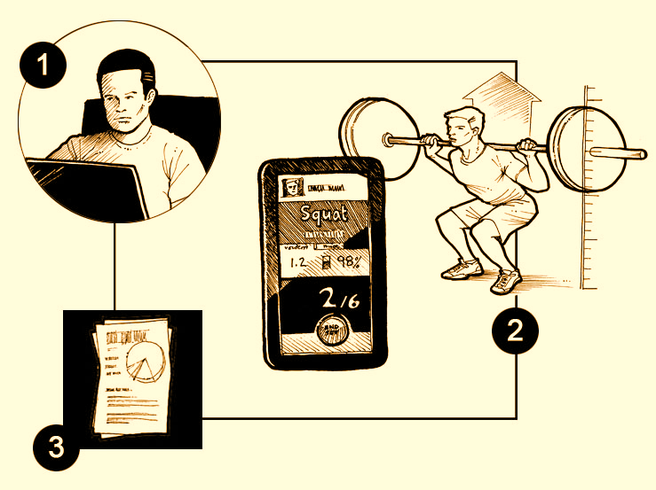
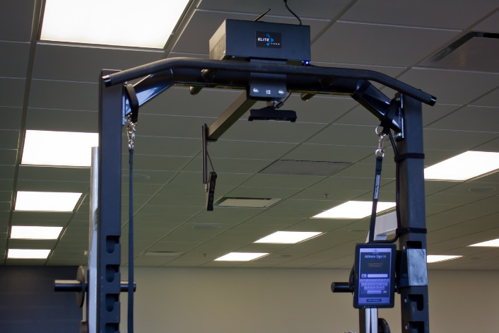
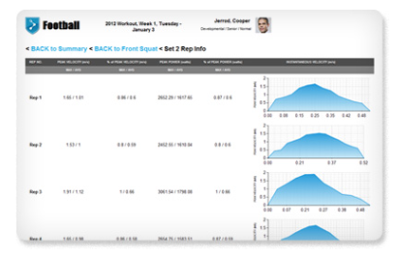
EliteForm Product
1. Design, Personalize, Deliver
2. Receive Instant Feedback and
Automatically Track Results
3. Track and Analyze Data
Notes:
This was an incredibly difficult problem to solve given the operating environment and accuracy requirements

Slide 32
EliteForm
Key Challenges and Design Criteria:
Providing a simple to use, yet flexible, user interface for design of strength and conditioning programs
Patent Pending Algorithms for tracking athlete weight-lifting exercises with extremely high degree of accuracy
Creating a seamless, flexible, and low-touch user experience for athletes
Providing mobile access for coaches and athletes
Enabling access to data for ad hoc analysis by researches and caches
Managing remote embedded systems
Creating a device and experience that becomes a seamless part of an athlete’s workout and survives the harsh conditions
R&D Process for Building Technology
Application Architecture Highlights
Power Tracker runs on a pc-based embedded appliance running Windows Embedded OS
Strength planner is a web-based client-server system with servers hosted by Nebraska Global
Paperless is a platform-agnostic web app
Microsoft SQL Server for database back-end
Cloud or on-premise deployment
Multi-tenant where appropriate or private, segmented databases as necessary
OLAP database for ad hoc analysis & data mining
http://www.eliteform.com
Notes:
PM – Required to work and coordinate with multiple product owners external to our organization
Digital Design/User Research – 1) lots of info and controls in a small touch form factor 2) had to create a simple, intuitive planning ui that supported substantially different strength theories
Mobile Device – Responsive mobile web app that worked full-featured and worked across all form factors (tablet and phone)
Hosting/Security – on-premise (seals) and cloud with security to protect sensitive athlete health and performance data
Analytics – created a database that enabled ad hoc data mining using standard off-the-shelf BI tools
Wearable – explored MEMS-based devices for both the exercise tracking as well as other use cases in the athletic performance realm

Slide 33

EliteForm
In use by dozens of elite athletic teams and military units
Millions of repetitions tracked
8 developers and 2 applied mathematicians
10 months from start to use by NU Football team
1 hot fix in last 12 months
Developed an automated test cluster for algorithm validation

Slide 34
Beehive Public Sector

Slide 35
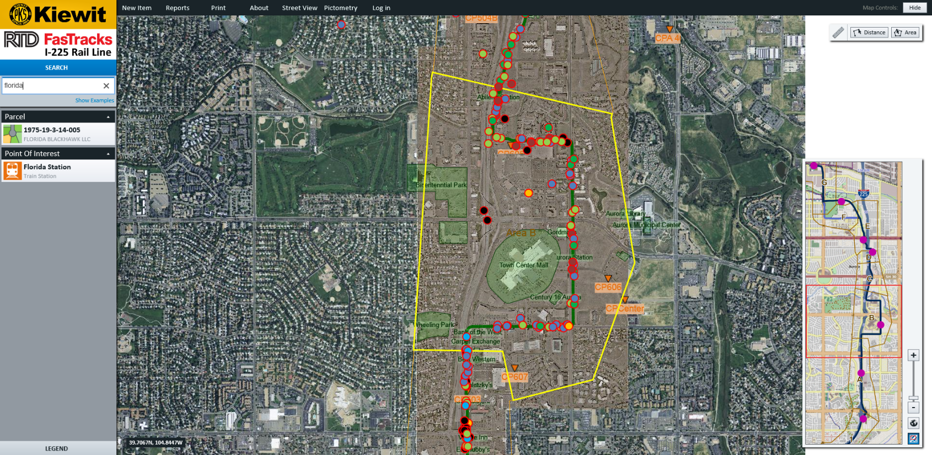
Beehive as a Platform
Self-service fence design
Highway construction management
Optimized tree placement

Slide 36
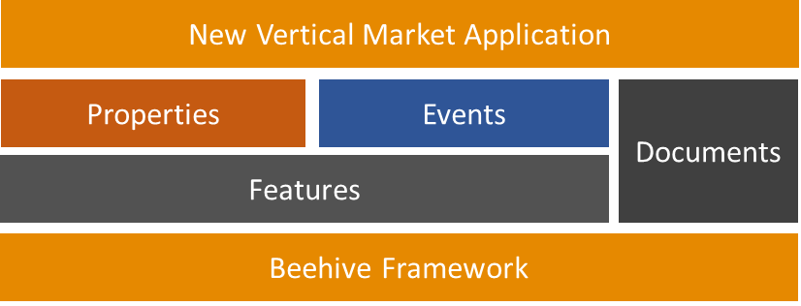
Beehive
Key Challenges and Design Criteria:
A platform that could be extended to a variety of industries and applications with minimal dev
Provide for disconnected use while leveraging a cloud-based infrastructure
Intuitive interface for knowledge workers and general public
Comprehensive, yet user-friendly public web portal for access to GIS data
Integrate with existing GIS database systems as well as working standalone
Provide a mobile experience that enables data access and collection in the field
Application Architecture Highlights
Combines rich desktop client with web portal
Data synchronization across clients and cloud
Hybrid on premise/cloud system
Hosted in Microsoft Azure and Amazon AWS
http://www.beehiveindustries.com/
Notes:
Digital Design – A key differentiator of this product is our ability to make complex data and relationships very accessible to both knowledge workers and the general public. This product is succeeding because we made GIS data as easy to view and use as Google Maps and Microsoft Office
Hosting/Cloud – Connected/disconnected modes enabled by a cloud umbrella. Was able to switch the platform over from Microsoft Azure to Amazon AWS literally in an afternoon.

Slide 37
Beehive
In use by dozens of public works departments and other agencies
8 developers, 1 QA engineer
6 months from start to use by first city
Automated the configuration control and nightly testing of all customer configurations
Weekly unattended releases
Include code and database schema updates

Slide 38
Key Takeaways
Agile processes work but don’t be afraid to hybridize
Building software is a complex activity – why wouldn’t you have a plan?
If you design your software to be unit testable, you are “80% there”
Don’t be afraid to make developers accountable for quality – remove the training wheels (i.e. QA)
Find a great project manager and trust them to handle all of the “noise”
Protect developer’s time

Slide 39
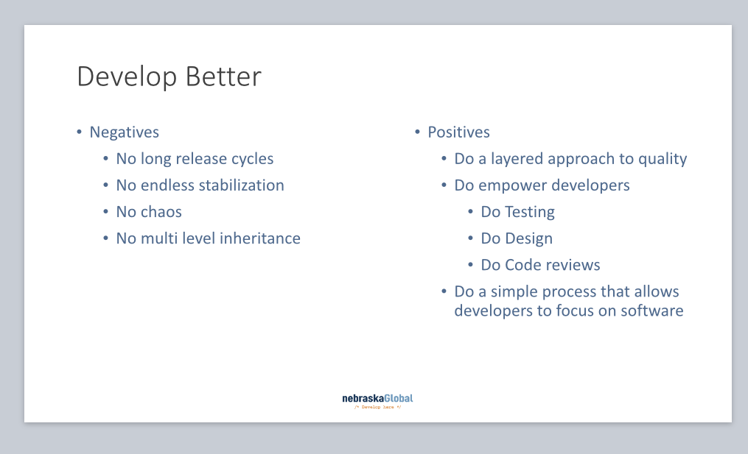

Slide 40
Summary of best practices
Consistent adoption of proven processes
Treat everything starting at story development as design
Strong project management role
Formalize an architecture process
“Service” orientation over object orientation in design
Design for testability
Multi-layered approach to quality
Continuous integration processes
Automated testing and deployment
Refactoring to maintain/improve the design

Slide 41
Takeaways
Planning is critical but “no operational plan ever survives first contact with the enemy”
Culture is critical
You must protect and nurture the key elements of your culture
Lead by example and your team will pick up the mantle
Treat everything as a design effort
If your story and task development are not taken seriously then chaos ensues and no value is derived
Developer accountability for quality
Design for testability
Don’t live in houses with broken windows
Laser focus on build success
Layered approach to quality
Be flexible in your processes
Enable growth and evolution of your tools, processes and practices
Let the developers focus on design/development (Maker’s schedule)
Develop a project manager role that can be a force multiplier
Develop project team leads who maintain “big picture” and ensure integrity of the design

Slide 42
Combining experience and the body of knowledge
Process Methodologies | Design Patterns and Principles | Business Models | Thought Leaders
Agile | Information Hiding | Business Model Canvas | David Parnas
Scrum | Service Orientation | Lean Startup | Fred Brooks
Extreme Programming | High Cohesion | Minimum Viable Product | Martin Fowler
Kanban | Loose Coupling |  | Robert C. Martin
Test-Driven Development | Dependency Injection |  | Steve McConnell
Waterfall | Closed Architectures |  | Kent Beck

Slide 43
Thanks!
“If builders built buildings the way programmers wrote programs, then the first woodpecker that came along wound destroy civilization.”
Gerald Weinberg
ddurham@dontpaniclabs.com
cmichel@beehiveindustries.com
http://blog.dontpaniclabs.com

